Slide 1
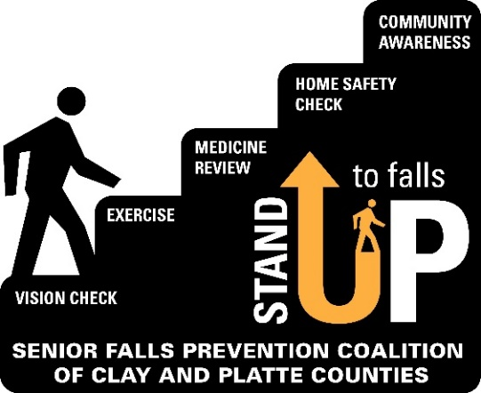
Senior Falls Prevention Coalition of Clay and Platte Counties
2023 Look Back and Looking Forward!

Slide 2
Thank you to all of our coalition members!
Ability KC
Assured Trust Co
AV Yoga and Wellness
Benton Houses of Kansas City
Chefs for Seniors
City of Gladstone
Clay County Senior Services
Department of Health & Senior Services
Good Samaritan Center
KC Lift & Elevator
Kearney Enrichment Council
Kearney Fire and Rescue
Liberty Silver Center
Lifescape Law & Development
Mals Medical Equipment
North Kansas City YMCA
Northland Shepherd’s Center
Northland Shepherd’s Center
Oak Pointe of Kearney Assisted Living & Memory

Slide 3
And more thanks to our coalition members!
Right at Home
Saint Luke’s Hospital Of Kansas City
SaRa Health
Shepherd Elder Law Group
Tri-county Mental Health Services
University Of Missouri Extension
Patt Papenfuhs
Platte County Health Department
Platte County Public Administrator’s Office
Platte County Senior Fund
Platte Senior Services
Rebuilding Together Kansas City

Slide 4
Educational Program Meetings 2023
Meetings were held virtually and in person
January – coalition goals for 2022; membership drive
February – Falls Data in Clay and Platte Counties – Presented by Erin Sanders, MPH | Epidemiology Specialist | Platte County Health Department and Stefani Mitchell, Health Data Analyst | Clay County Public Health Center
March – Collaborating on Fall Education and Prevention *How we get it done *Better Together Presented by Kathy Armitage
April – “Older adults who resistance train improve physical function and adopt long-term exercise habits despite COVID-19 restrictions.” Presented by Kristin Miller and Kelsey Weitzel, University of Missouri
May – Ageism: “What can we do about it? Reflect and act”. Presented by Paula Zigmond, Program & Resources Manager, Clay County Senior Services

Slide 5
Educational Program Meetings 2023
June – Special event in honor of Elder Abuse Awareness Month Financial Fraud & Scheme Awareness - presented by Jackie Murtha, VP, Clay County Savings Bank
Overview of Missouri Adult Protective Services - presented by Tim Jackson, MO DHSS/DSDS
Direct Adult Protection Services Program - presented by Victoria Jackson, MARC
July – Ice cream social event
August – Older-Adult Safe Driving Programs
Presented by Jessica Giacone, BSN, RN, CCRN,Trauma Outreach & Injury Prevention Coordinator, Saint Luke’s Hospital and Olivia Desmairas, MSN, RN, CCRN, TCRN, CPHQ, Trauma Injury Prevention Education Specialist, University of Kansas Health
September - National Falls Prevention Awareness Week
October – Medicare
Presented by The Medicare Whisperer, Patricia Engelage
November – Caregiving & Falls Prevention
Presented by Amy Vance, AV Yoga & Wellness

Slide 6
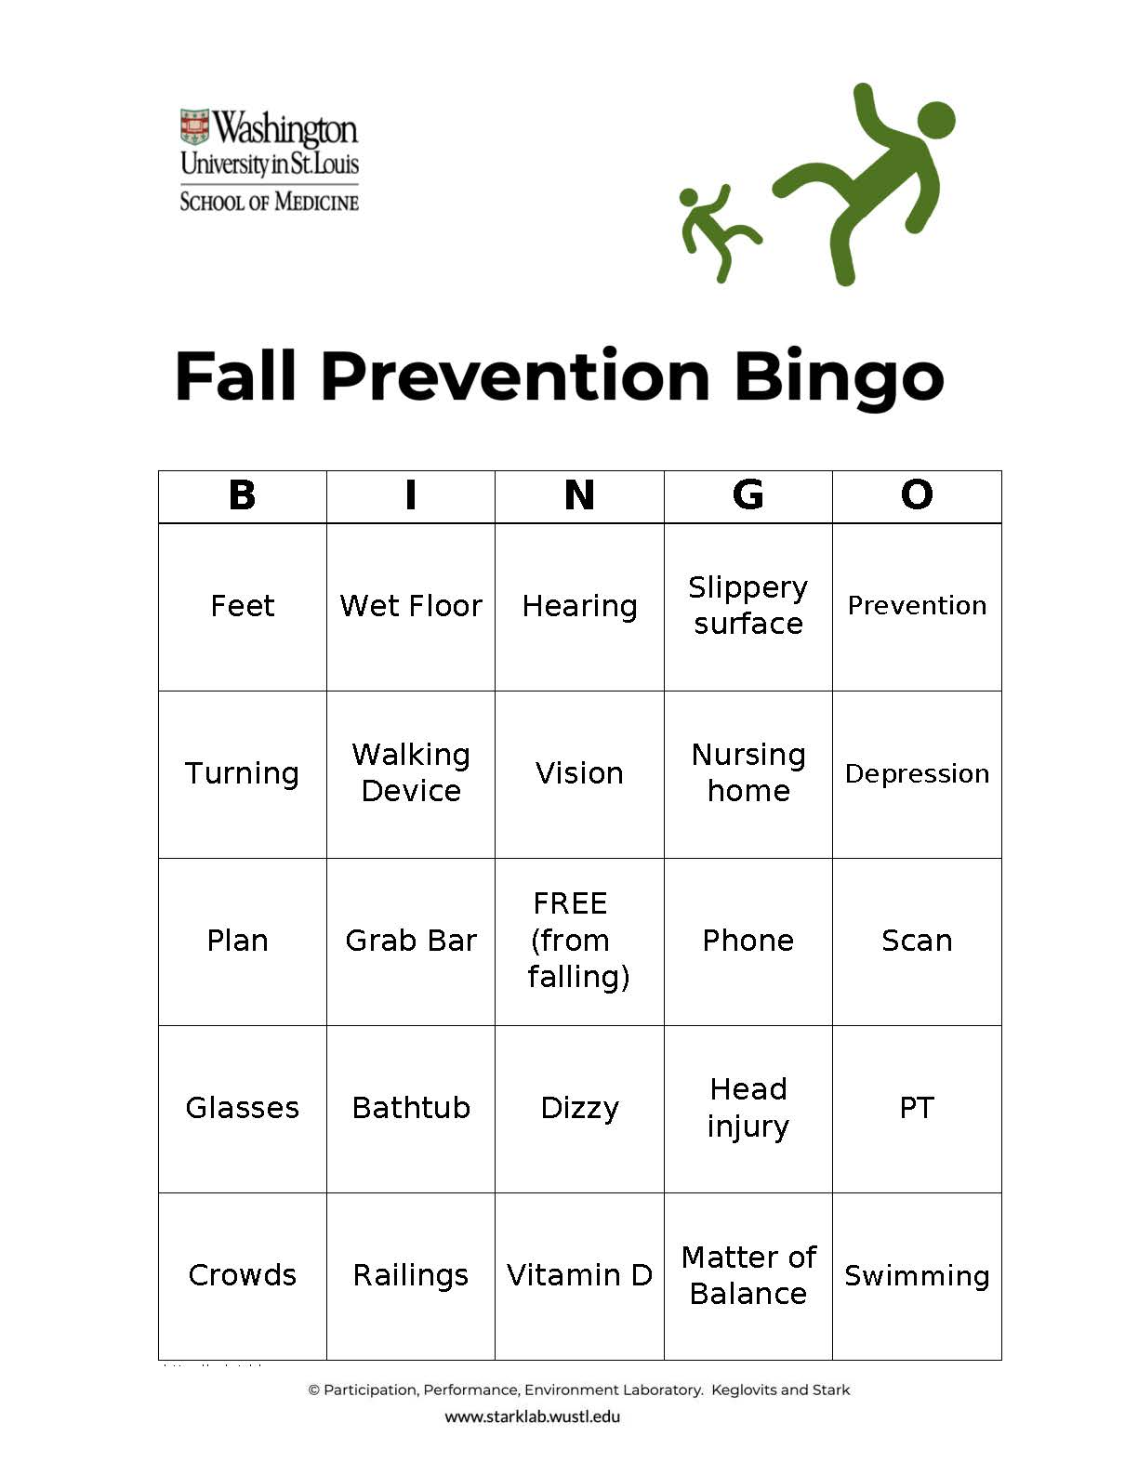
Falls Prevention Awareness Events
September 28 – Falls Prevention Seminar & Fair, Platte Co. Community Center South
Falls Prevention Bingo Tour all month long!
9/18 at Benton House, Staley Hills 9/20 at Kearney Senior Center 9/22 at Benton House, Tiffany Springs 9/28 at Platte Co Community Center South 9/29 at Smithville Senior Center

Slide 7
Falls Prevention Coalition Presence at Community Events
Falls Prevention Bingo events in May at Parkville Living Center and Northland Shepherd’s Center
Platte County Senior Fair in September – members provided information on falls prevention at their booths.
Clay County Resource Fair in October - members provided information on falls prevention at their booths.

Slide 8
Partnerships
We continue to get referrals from local Fire & EMS agencies and partner with Gladstone Fire-EMS, Kearney Fire & Rescue Protection District, NKC Fire Department, Excelsior Springs Fire Department, Northland Regional Ambulance District, and KCMO Fire Department.
CAPABLE with NKC Hospital Home Health.
Northland Living Well Collaborative agencies offered A Matter of Balance at Northland Shepherd’s Center, Smithville Senior Center, Excelsior Springs Colony Plaza, NKC Parks & Recreation.
MARC is now funding home modifications; in the Northland partner agencies are Rebuilding Together Kansas City and Northland Neighborhoods, Inc.
With area hospitals to include falls prevention information in their discharge plans.

Slide 9
Leadership and Education
Tina Uridge presented at the Gladstone Rotary and received a $200 donation to the SFPC.
for the Show Me Falls Free Missouri Coalition meeting in July: Karl Schafer participated on a panel of Physical Therapists; Tina Uridge presented on developing and sustaining a falls prevention coalition.
Drive-thru food distribution events included falls prevention information.
Meals on Wheels participants received falls prevention information.
Oh and not to forget… SFPC members showcase their organizations each month during the Agency Spotlight at our meetings!

Slide 10
Exercise and Balance Programs were offered throughout 2023
Aging with Excellence at Northland Shepherd’s Center
A Matter of Balance
Chair Yoga and Chair Stretching
Peer Exercise Program Promotes Independence
L.I.F.T. (Life Improving Fitness Training)
University of Missouri Extension
Stay Strong Stay Healthy
A Matter of Balance
Walk with Ease
AV Yoga and Wellness
Yoga
Tai Chi
A Matter of Balance
Kearney Firehouse Kearney Senior Center
PEPPI A Matter of Balance
Sassy Senior Cardio & Weight Exercise

Slide 11
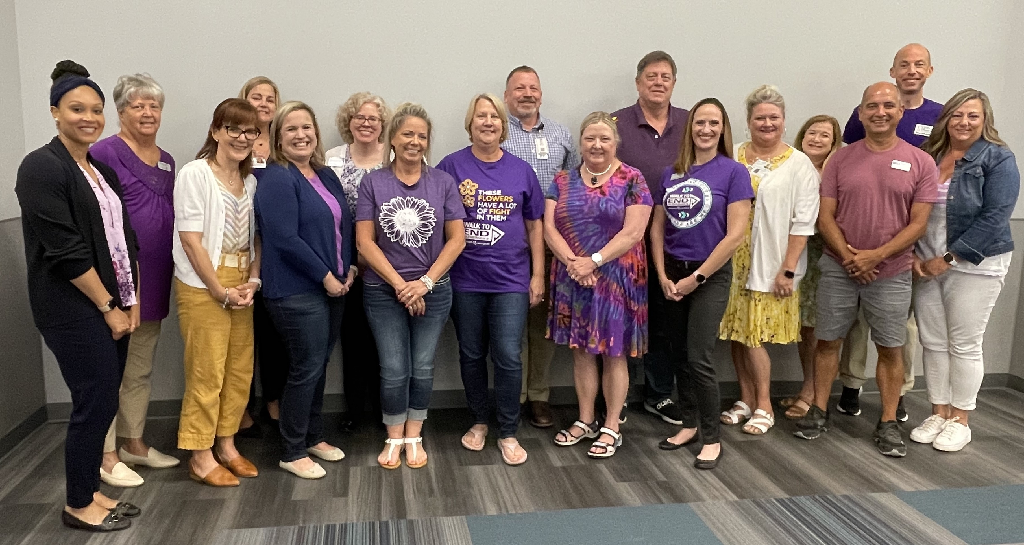
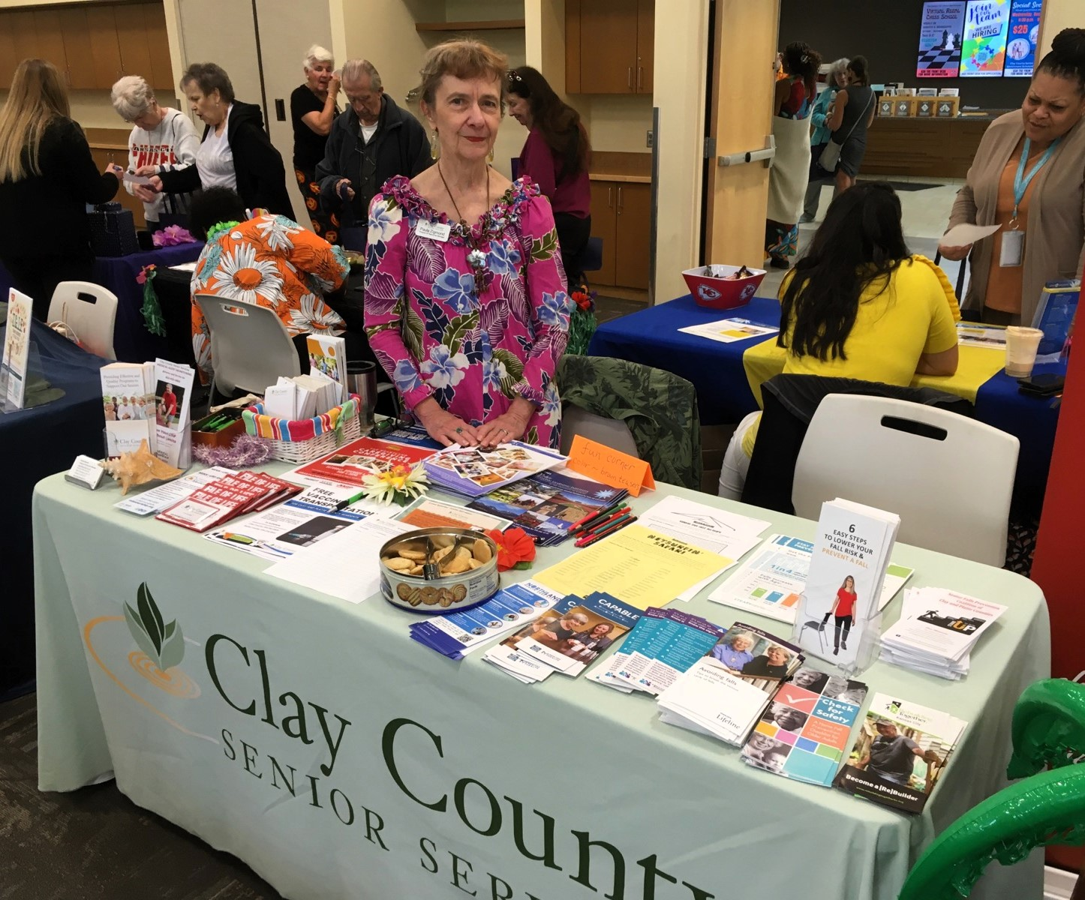
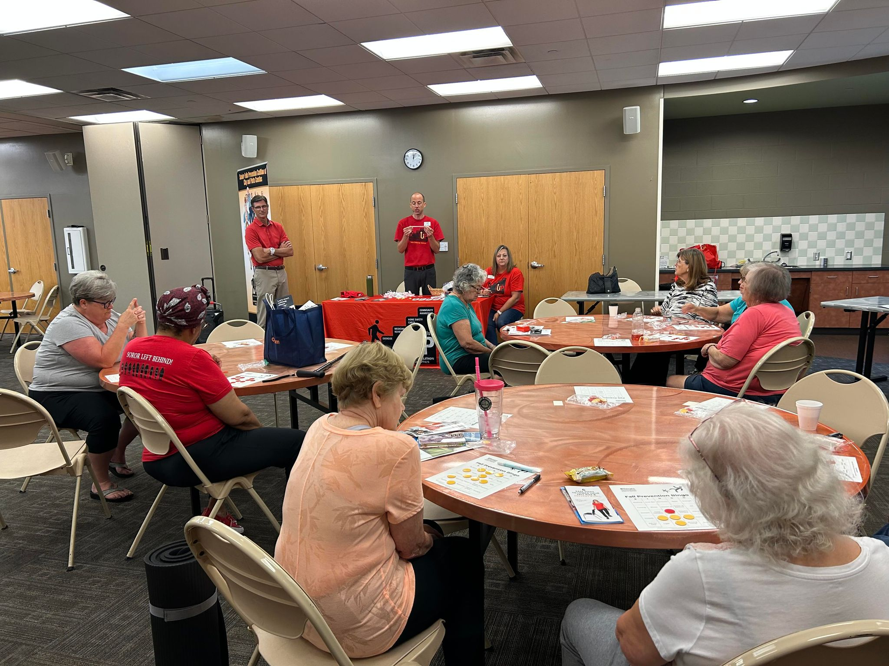
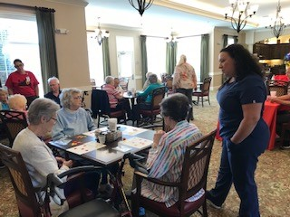
Every picture tells a story

Slide 12
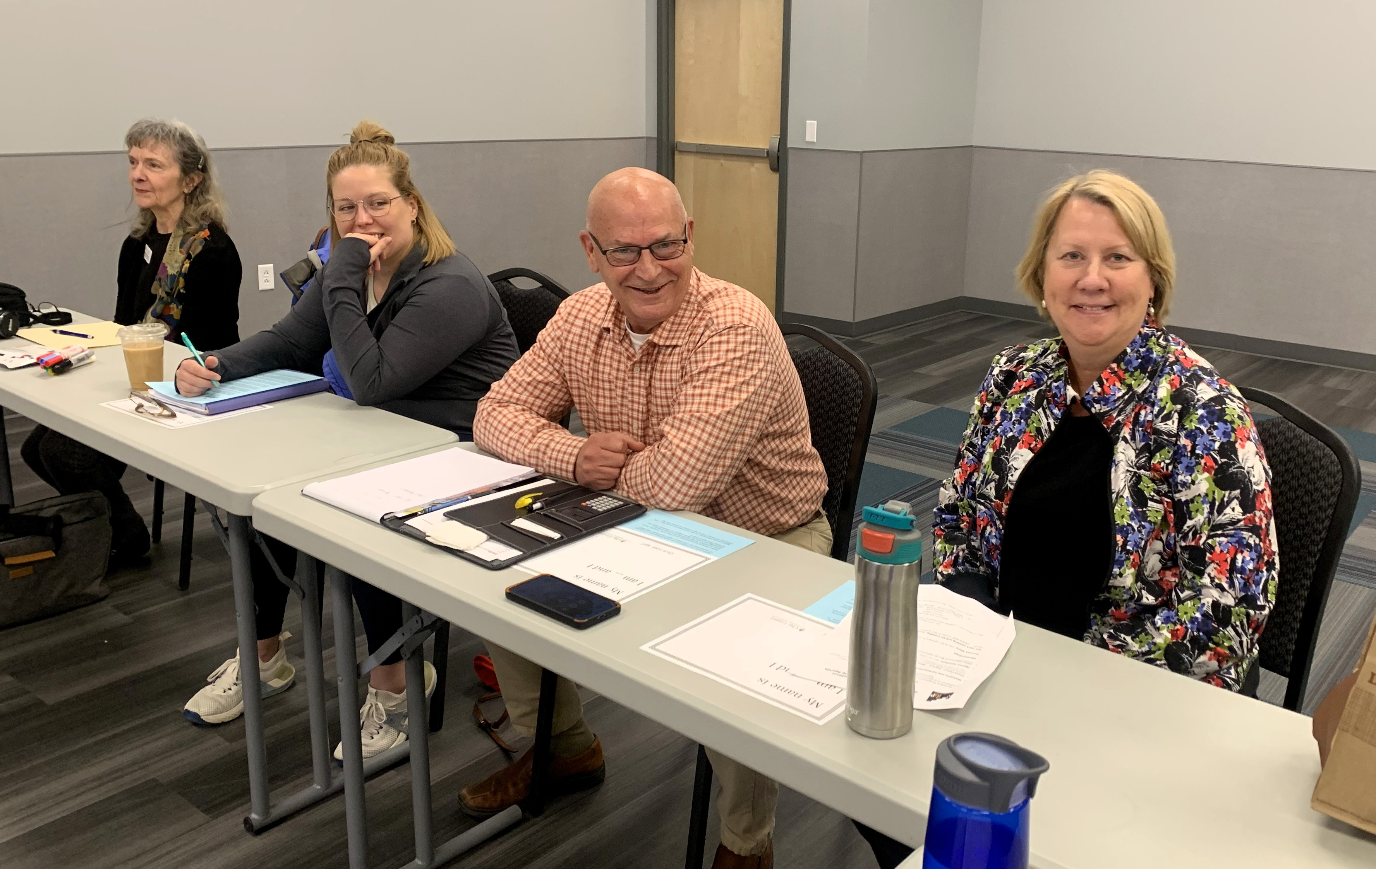
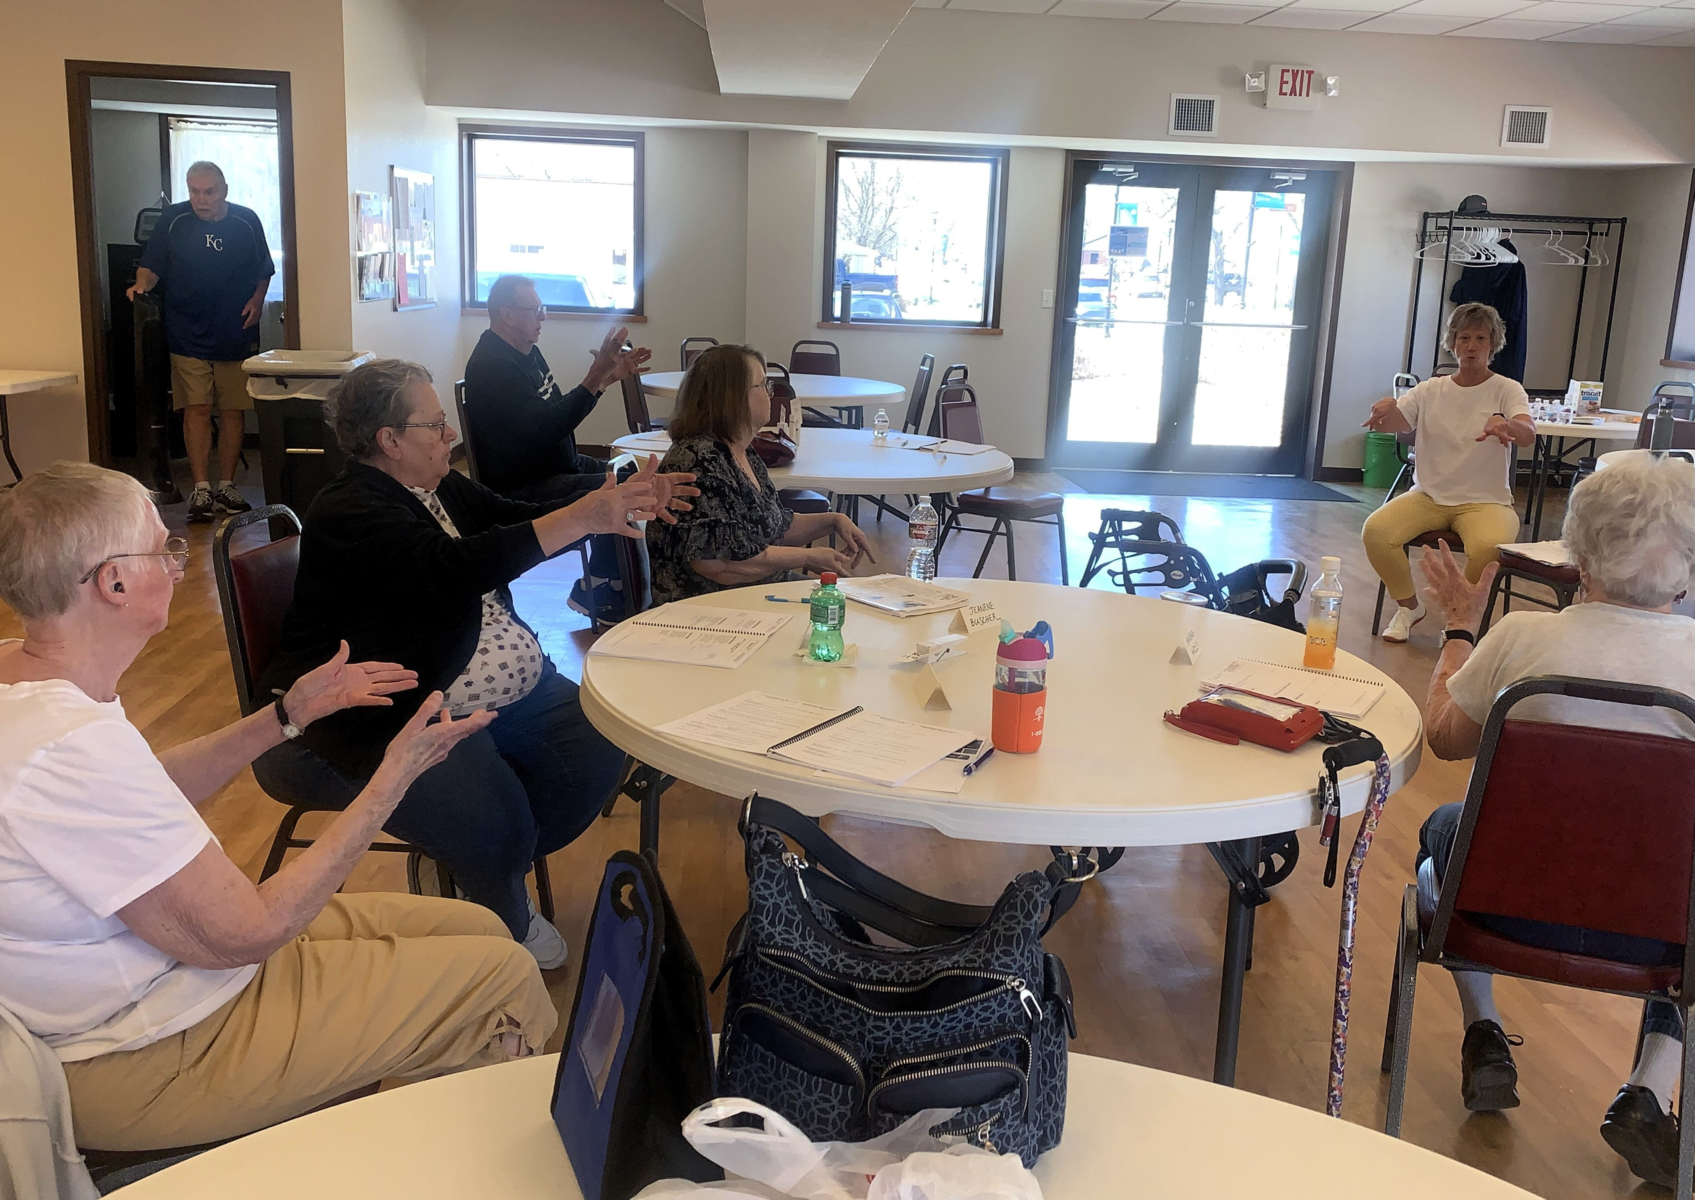
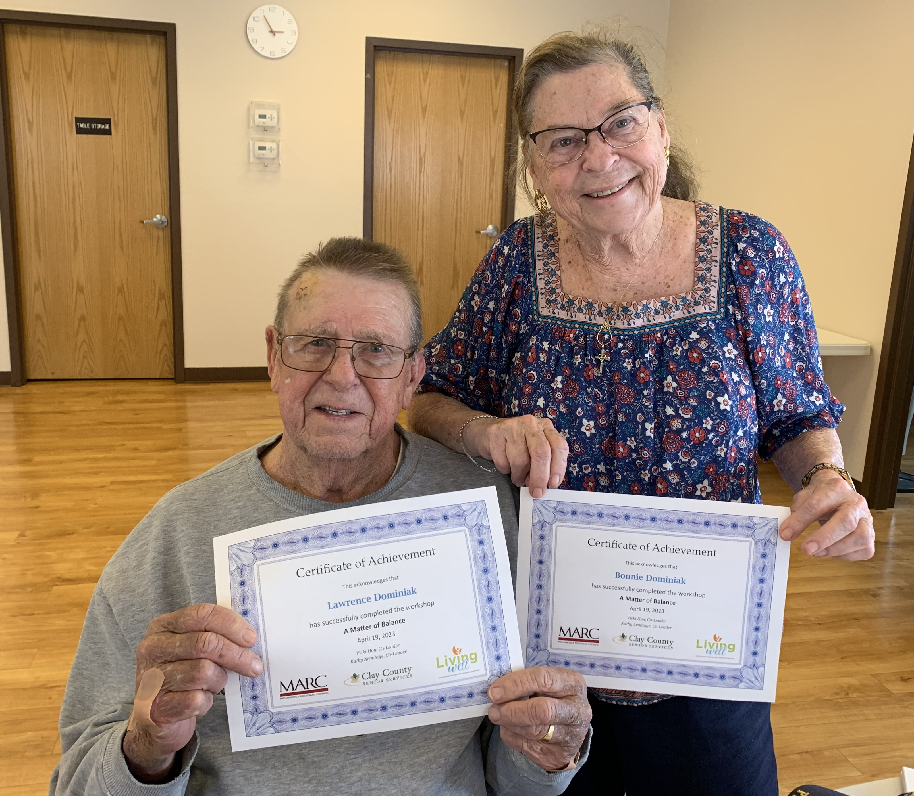
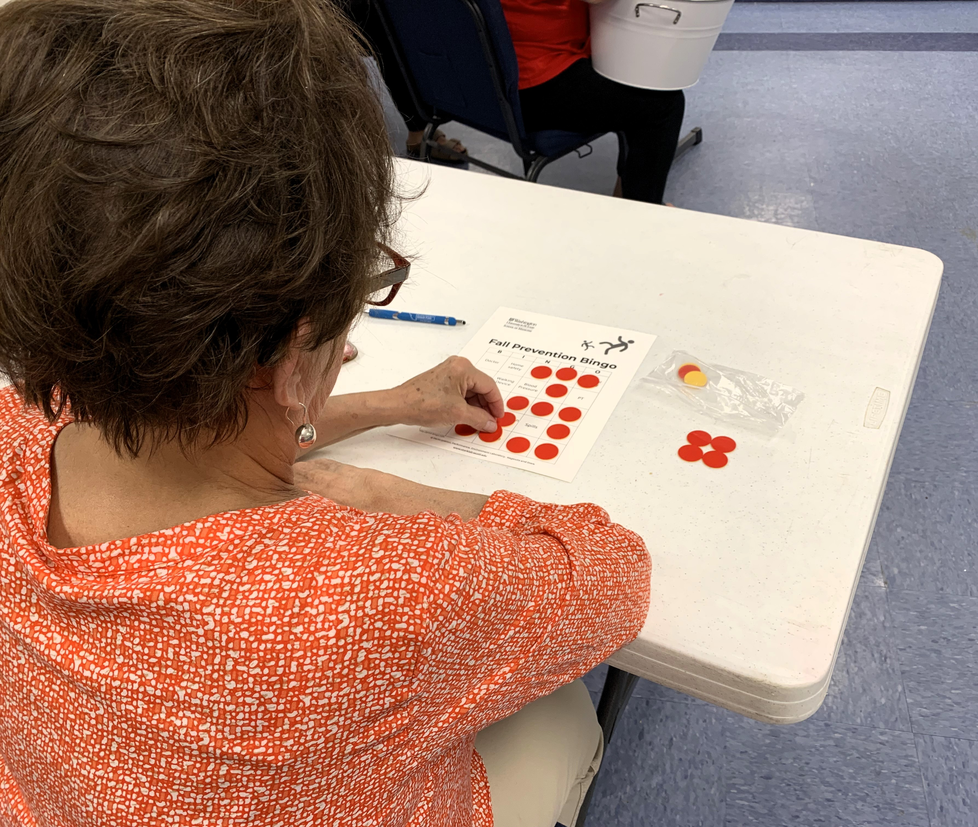
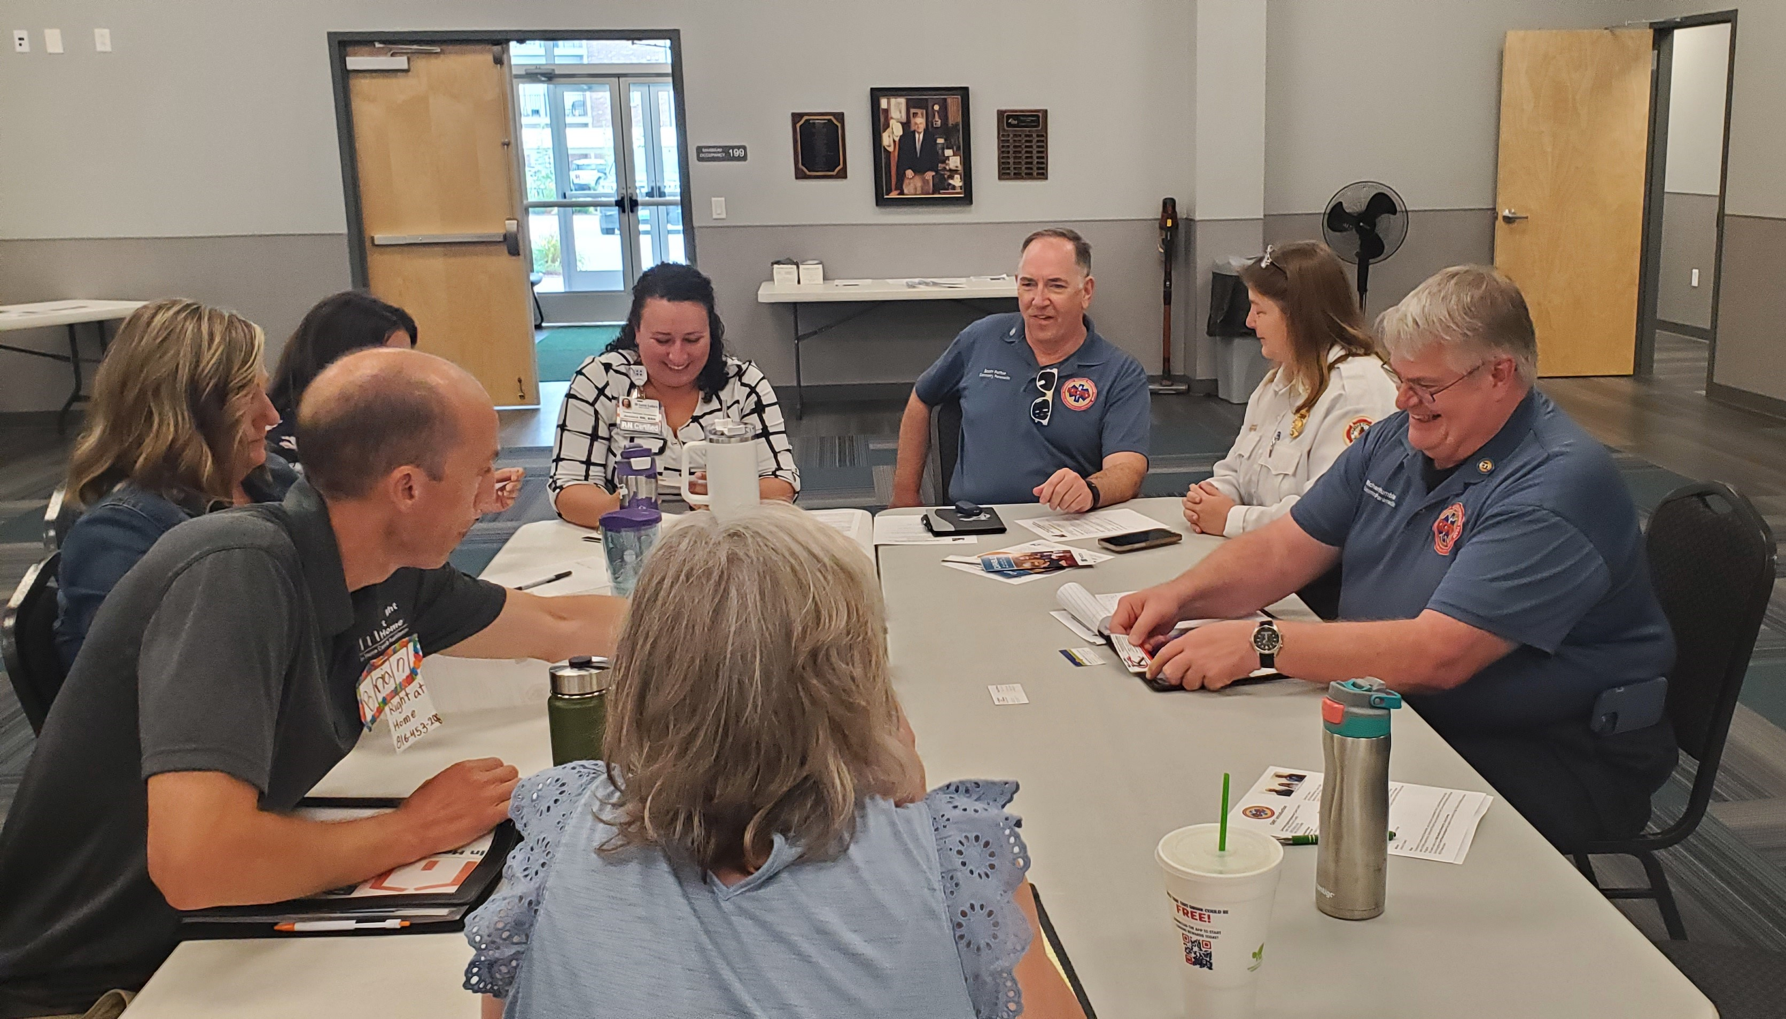

Slide 13
joyful Holidays to all!
We appreciate your attendance at our monthly meetings and your continued dedication to keeping older adults safe in their homes.
Join us on Tuesday, January 9, 2024 at Northland Neighborhoods, Inc.
We will plan our goals for the new year.

